Slide 1



Aggregate Customization images

Slide 2
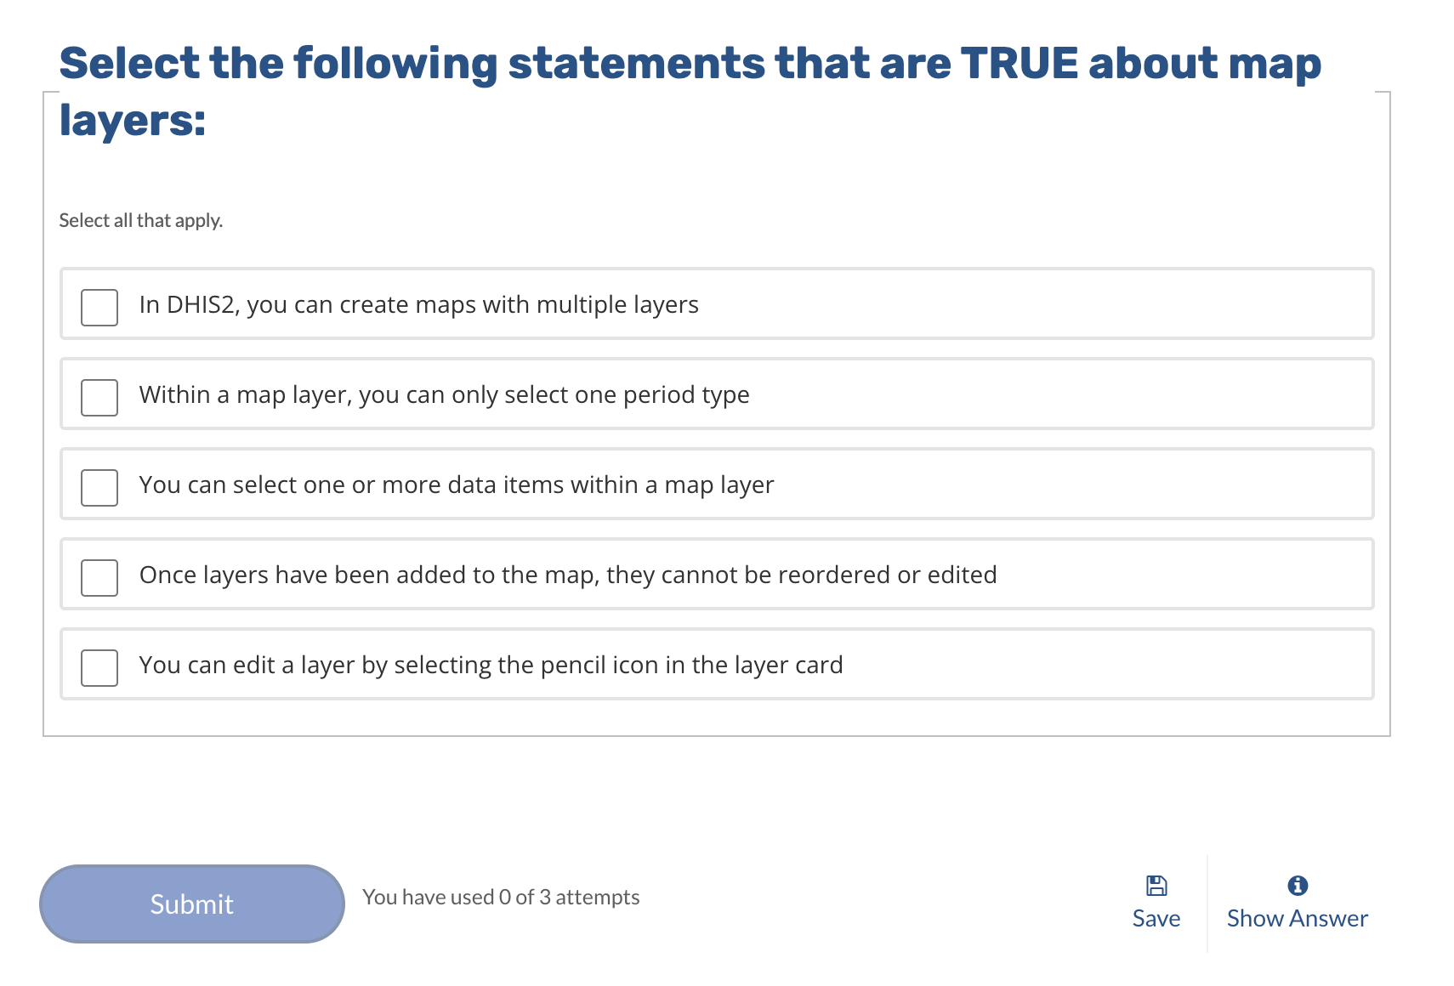
1
2
3
4
5

Slide 3

Country
Provinces
Districts
Facilities

Slide 4
Disaggregation
< 1 year
1 – 4 years
> 5 years
Male
Female

Slide 5
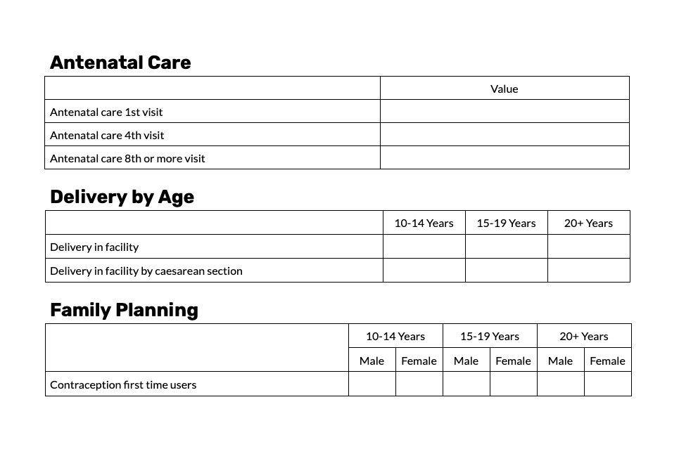
1
2
4
3
5

Slide 6
Antenatal care
Antenatal care 1st visit
Antenatal care 4th visit
Antenatal care 8th or more visit
Delivery by age
 | 10 – 14 Years |  | 15-19 Years |  | 20+ Years
Delivery in facility
Delivery in facility by caesarean section
Family planning
 | 10 – 14 Years |  | 15-19 Years |  | 20+ Years
 | Male | Female | Male | Female | Male | Female
Contraception first time users

Slide 7
Treatment
 | Value | Value | Value
Cases treated with any antimalarial medicine (incl. ACT)
P. Falciparum cases treated with single dose primaquine and ACT
P. Falciparum cases treated with ACT only
Cases
 | Value
 | 0 –4 Years |  | 5-114 Years |  | 15+ Years
Suspected malaria cases
Confirmed malaria cases
Laboratory
 | Value
 | 10 – 14 Years |  | 15-19 Years |  | 20+ Years
 | Male | Female | Male | Female | Male | Female
Malaria cases tested with microscopy
Malaria cases positive with microscopy
1
2
4
3
5

Slide 8
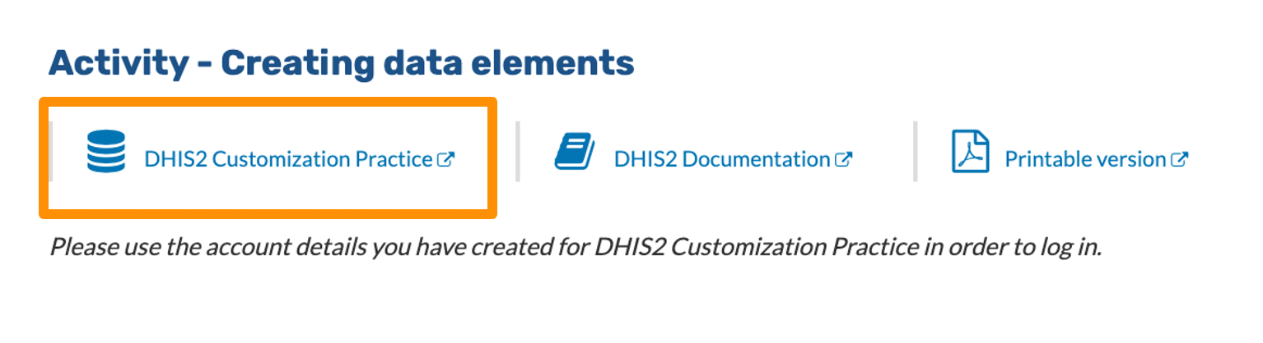

Slide 9
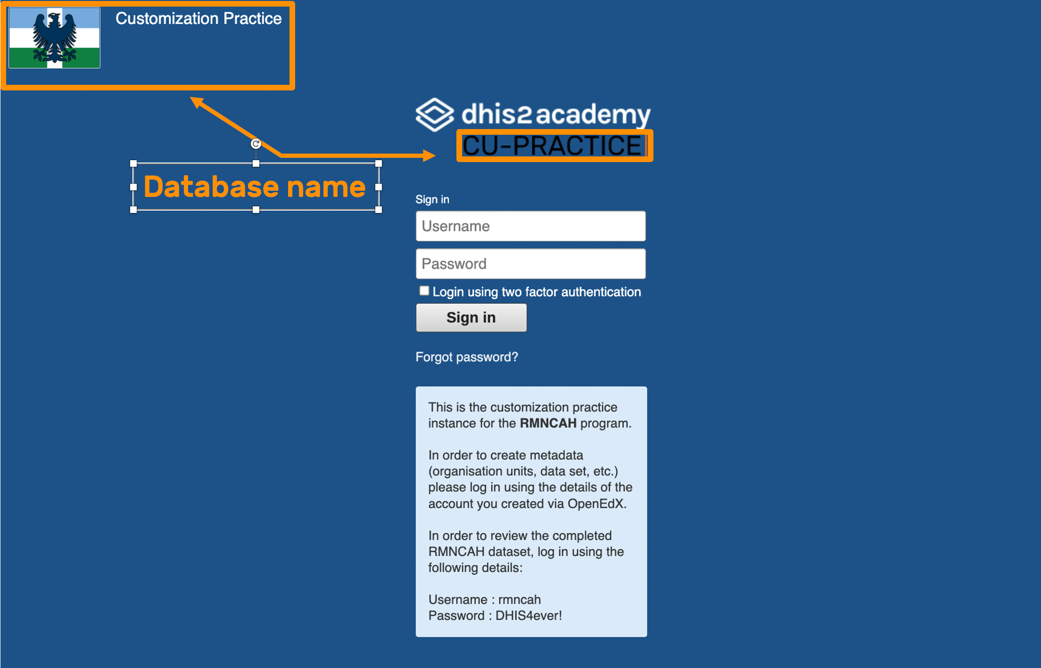

Slide 10

Training databases
Learner view
Admin view
Example metadata
Items created
Can view and access metadata created by learners

Slide 11
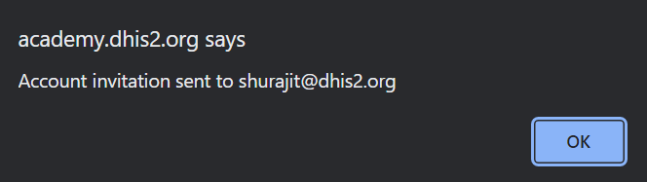


Slide 12
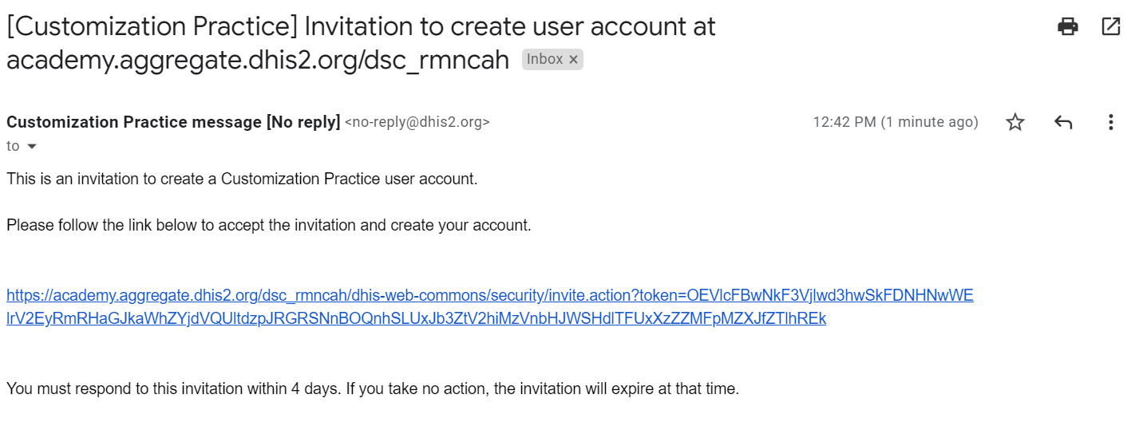

Slide 13
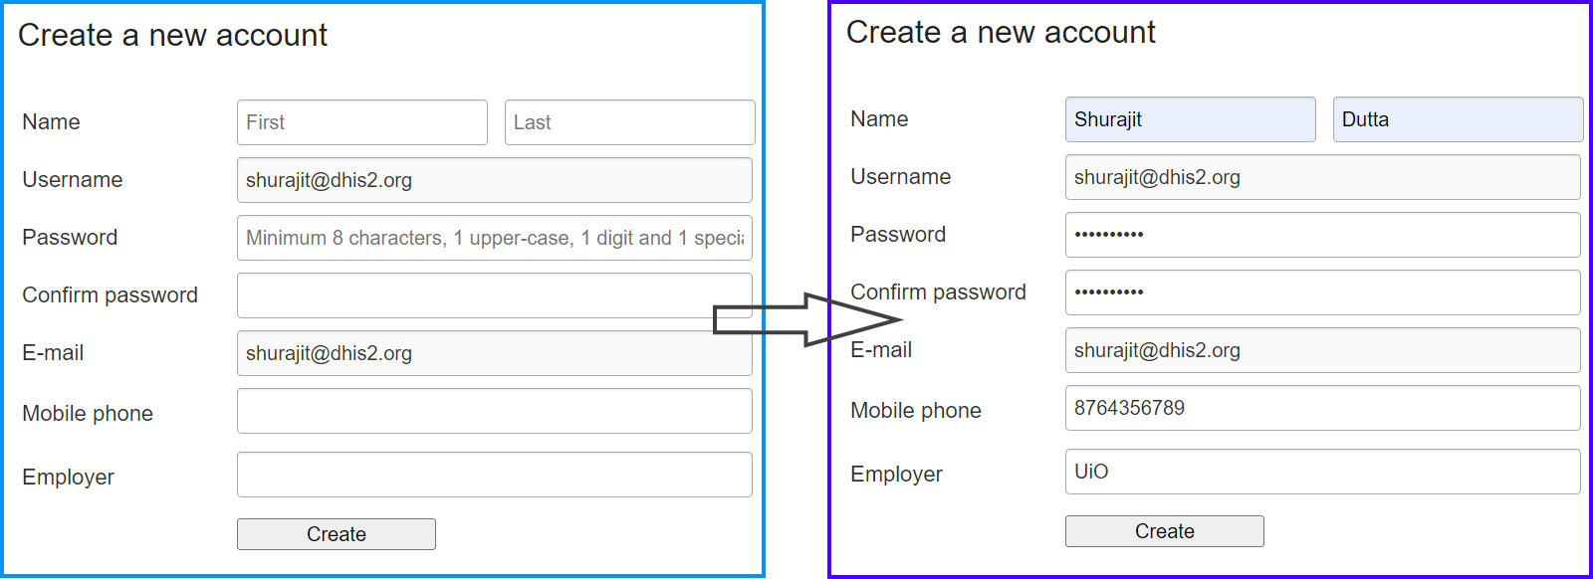

Slide 14
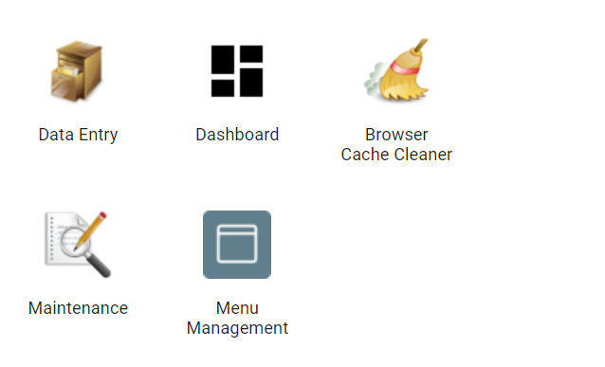
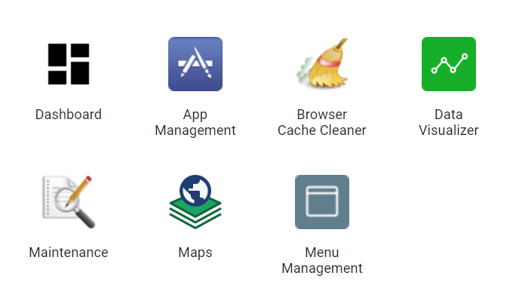

Slide 15
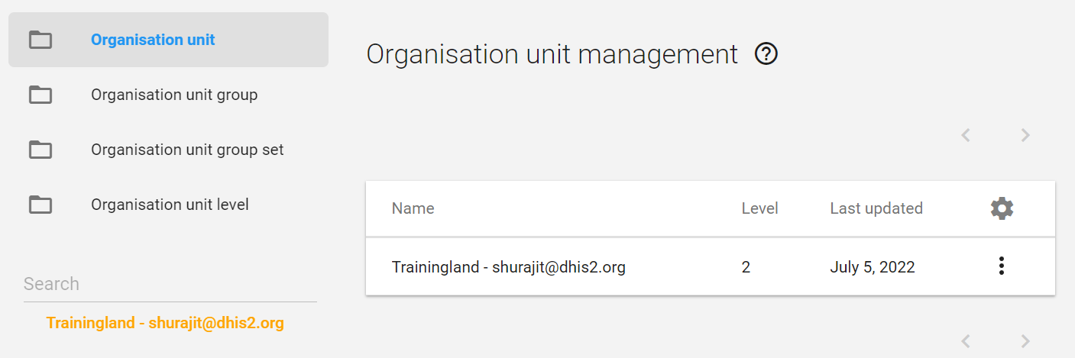

Slide 16
Organisation unit group set
Type of facility
Organisation unit groups
Dispensary
Health
Center
Specialist Hospital
Referral Hospital

Slide 17
1
Open the Maintenance application
2
Navigate to the organisation unit management page
3
In the organisation unit hierarchy, select the parent organisation unit
4
Click on the blue (+) sign on the bottom right of the screen
5
Fill in the name and other information in the organisation unit creation form
6
Click “Save”

Slide 18
1
2
3
4
5
6
7

Slide 19
Root OU | Region | District | Facility
Trainingland | Food Region | Vegetable District | Carrot District Hospital
 |  |  | Spinach Health Center
 |  | Fruit District | Apple Health Center
 |  |  | Banana District Hospital
 |  | Dinner District | Spaghetti Health Center
 |  |  | Lasagna Private Hospital
 |  |  | Ostrich Health Center
 |  |  | Herring Health Center

Slide 20
Org. Unit Group Set | Org. Unit Group | Org. Unit Name

Slide 21
Root OU | Region | District | Facility
Root – Your name | Your initials_Animal region | Your initials_Bird District | Your initials_Ostrich Health Center
 |  |  | Your initials_Peacock Private Hospital
 |  | Your initials_Dog District | Your initials_Bulldog Health Center
 |  |  | Your initials_Dalmatian Private Hospital

Slide 22
Org. Unit Group Set | Org. Unit Group | Org. Unit Name
Your initials_Ownership Type | Your initials_Private | Your initials_Peacock Private Hospital
 |  | Your initials_Dalmatian Private Hospitak
 | Your initials_Public | Your initials_Bulldog Health Center
 |  | Your initials_Ostrich Health Center

Slide 23
1
2
3

Slide 24
Cases
 | Value
 | 10 – 14 Years | 15-19 Years | 20+ Years
Suspected malaria cases
Confirmed malaria cases

Slide 25
Category Options | Category | Category combination

Slide 26
Laboratory
 | Value
 | 10 – 14 Years |  | 15-19 Years |  | 20+ Years
 | Male | Female | Male | Female | Male | Female
Malaria cases tested with microscopy
Malaria cases positive with microscopy

Slide 27
Category Options | Category | Category combination

Slide 28
“What”
Data Elements
VS.
Indicators
Collected data
Calculated values
Cases of a disease
Using two or more data elements
Population data
Number of hospital beds
Immunization coverage
Maternal mortality rate
Total of data elements

Slide 29
Form Name | Category combination
Cases treated with any antimalarial medicine (incl. ACT)
P. falciparum cases treated with single dose primaquine and ACT
P. Falciparum cases treated with ACT only
Suspected malaria cases
Confirmed malaria cases
Malaria cases tested with microscopy
Malaria cases positive with microscopy

Slide 30
Form Name | Data Element group | Data Element Groupset
Cases treated with any antimalarial medicine (incl. ACT)
P. falciparum cases treated with single dose primaquine and ACT
P. Falciparum cases treated with ACT only
Suspected malaria cases
Confirmed malaria cases
Malaria cases tested with microscopy
Malaria cases positive with microscopy

Slide 31
Default form
Section form
Custom form

Slide 32
1
3
2
4
5

Slide 33


Data element
Indicator type
Numerator
Indicator
=
X
Factor
Denominator
Data element

Slide 34

DONE
Numerator
Delivery in facility
Institutional delivery rate
=
X
100
Population live births
Factor
Denominator
Notes:
Here in this formula, we can see that immunization coverage is calculated by +dividing doses given--the numerator--by the target population--+the denominator--and multiplied by a +factor of 100 to get a percentage.

Slide 35
DONE
ANC 4th visit
ANC 4TH visit coverage
=
X
100
Population expected pregnant women
Notes:
Here in this formula, we can see that immunization coverage is calculated by +dividing doses given--the numerator--by the target population--+the denominator--and multiplied by a +factor of 100 to get a percentage.

Slide 36
DONE
(Monthly)
Annualization
ANC 4th visit
X 12
ANC 4TH visit coverage
=
X
100
Population expected pregnant women
(yearly)
Notes:
Here in this formula, we can see that immunization coverage is calculated by +dividing doses given--the numerator--by the target population--+the denominator--and multiplied by a +factor of 100 to get a percentage.

Slide 37
DONE
ANC 1st visit – ANC 8th visit
ANC 1-8 dropout rate
=
X
100
RMNCAH– ANC 8TH visit
Notes:
Here in this formula, we can see that immunization coverage is calculated by +dividing doses given--the numerator--by the target population--+the denominator--and multiplied by a +factor of 100 to get a percentage.

Slide 38
v
v
Total number of malaria cases
=
X
v
v

Slide 39
v
Malaria cases treated with animalarial (%)
=
X
v
v
v

Slide 40
v
ANC coverage
=
X
v

Slide 41
v
v
v
ANC 1 to 8 drop out rate
=
X
v

Slide 42
Creating Indicator Groups
Creating Indicator Groupsets
vs.
1
Open the Maintenance app
1
Open the Maintenance app
2
2
3
3
4
Click on the blue plus (+) sign
4
Click on the blue plus (+) sign
5
5
6
6
7
Click “Save”
7
Click “Save”

Slide 43
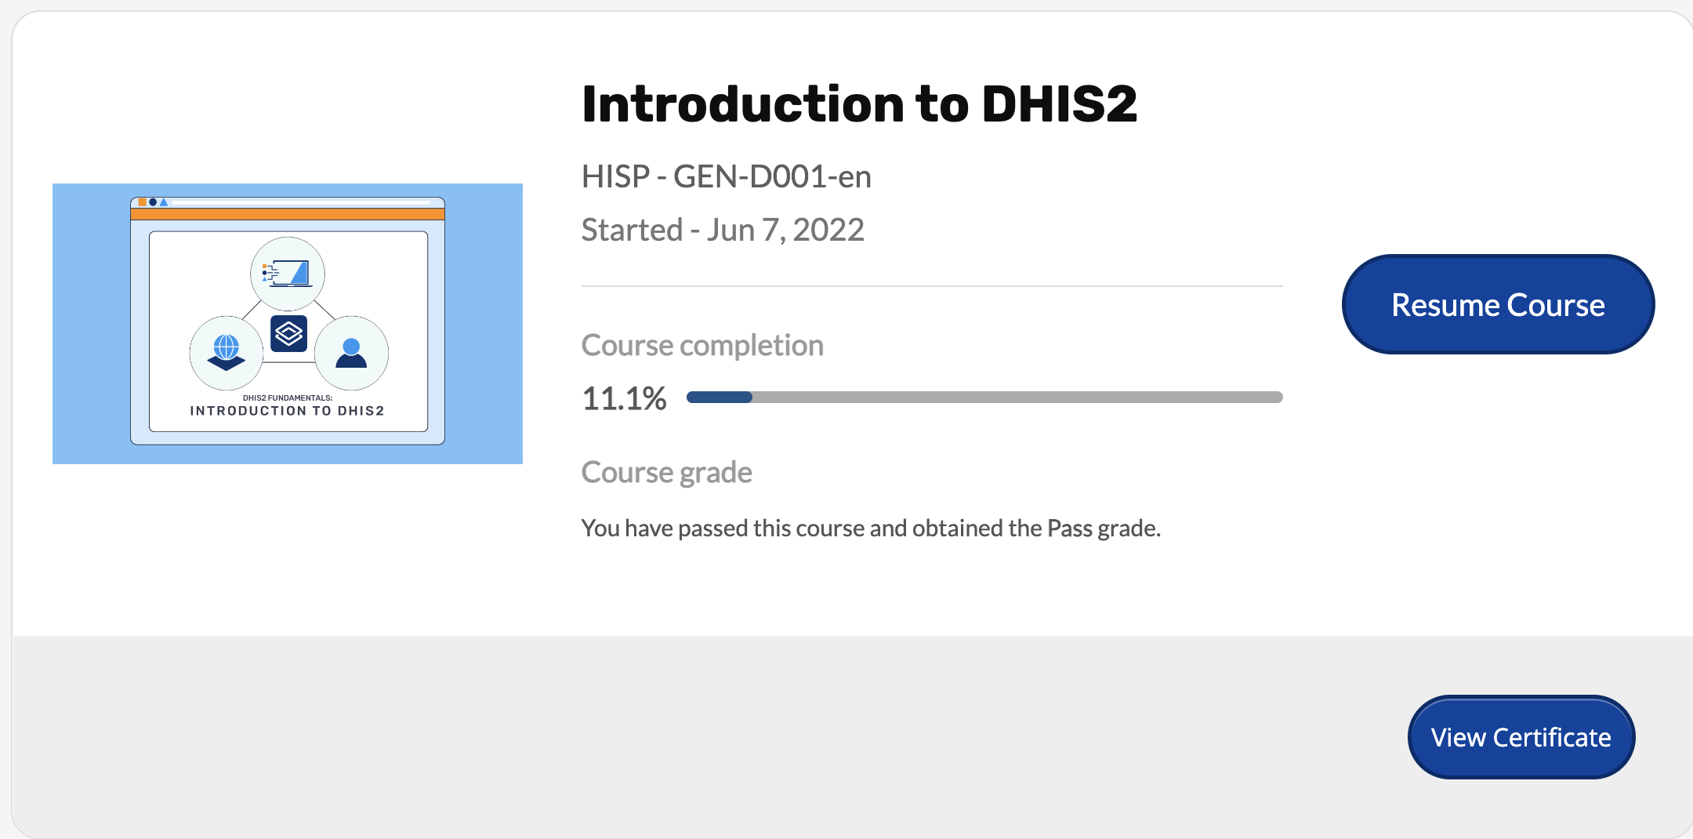
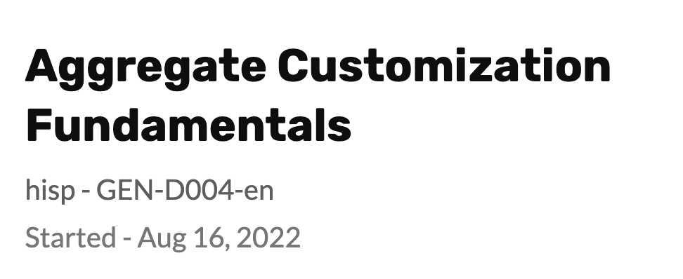
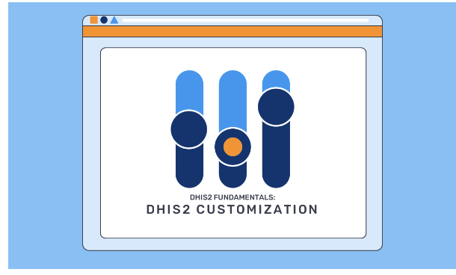

DONE
Click here to view and download certificate
Notes:
Here in this formula, we can see that immunization coverage is calculated by +dividing doses given--the numerator--by the target population--+the denominator--and multiplied by a +factor of 100 to get a percentage.

